Slide 1



Exploring Market Trends in the Used Bike Segment (Bikes4Sale.in)
By :- Nikhil Borade

Slide 2
About me :
Name :- Nikhil Borade
Education:- Batchelor's in Computer Science(2025)
https://github.com/NiksNk555
https://www.linkedin.com/in/nikhil-borade-307747314/

Slide 3
Business Problem :
The used bike market is growing but highly fragmented.
Buyers face issues like price fluctuations, inconsistent vehicle condition, hidden defects, and lack of service/ownership transparency.
Objective of the Project :
Analyze the used bike market using data-driven insights to optimize pricing, predict demand, improve customer experience, ensure fair valuation, detect fraud, and enhance decision-making efficiency.

Slide 4
Web Scraping :
For the web scraping process, I focused on extracting used bike data from Bike4Sale. Using Python and libraries like Requests, Beautiful Soup, and Regex. I sent HTTP requests to retrieve the HTML content of the bike listings.
The data points collected include Bike Company, Bike Model, Model Year, Price, Finance Available(Yes/No), City, and State columns .
I ensured compliance with the site's robots.txt and Terms of Service throughout the project.
After scraping, I cleaned and stored the data in a structured format like CSV for further analysis.
To handle pagination, I extracted and navigated through multiple pages to gather data from the entire site.

Slide 5
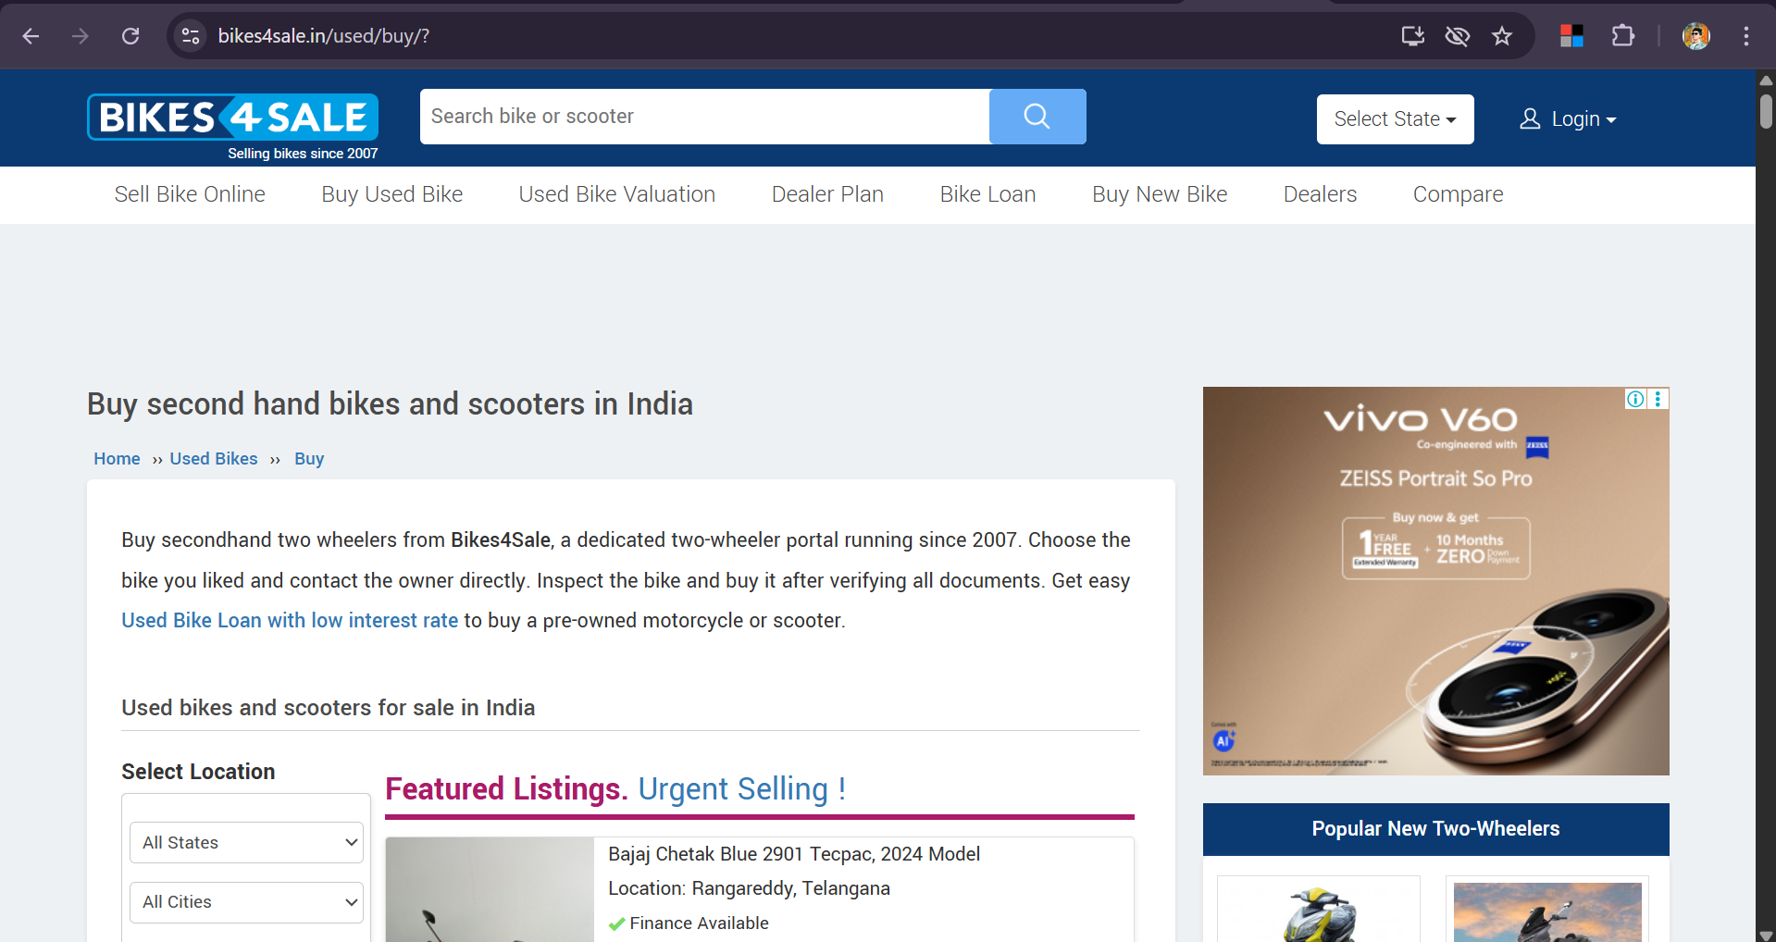
First Look of Websight :-

Slide 6
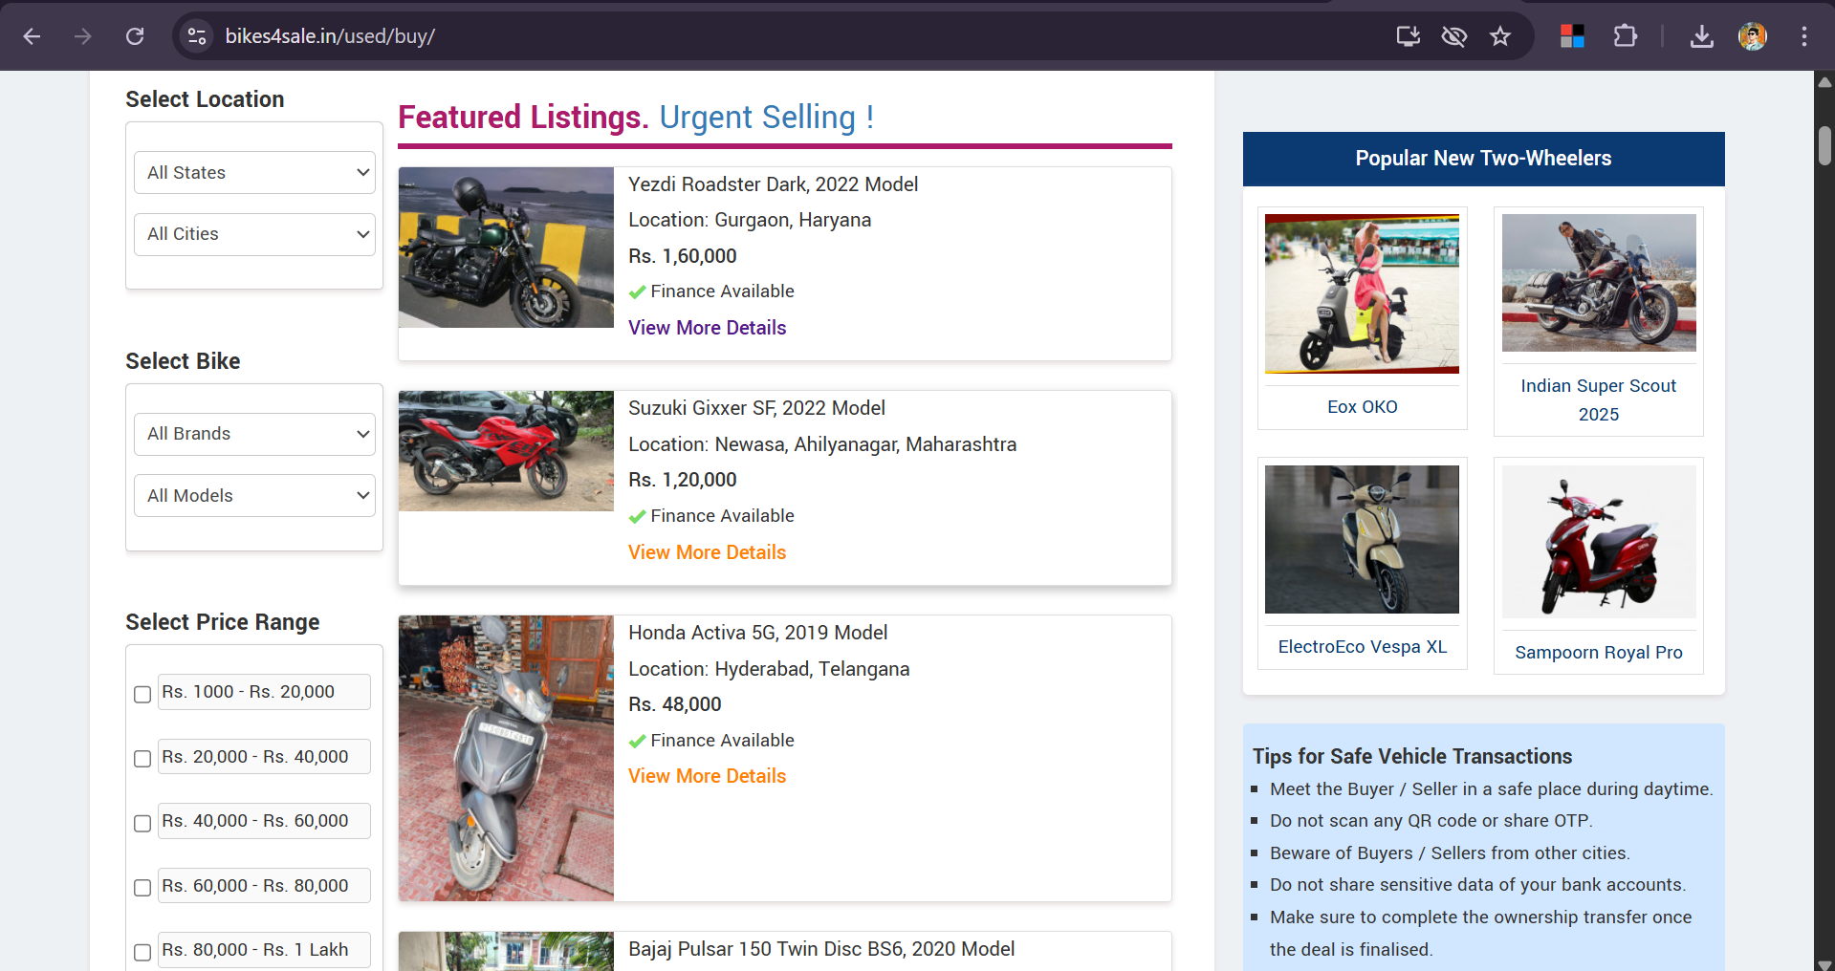
Containers From Which I have Scraped the Data:-
Bike Model
Model Year
Location
Price
Finance Available(Yes/No)

Slide 7
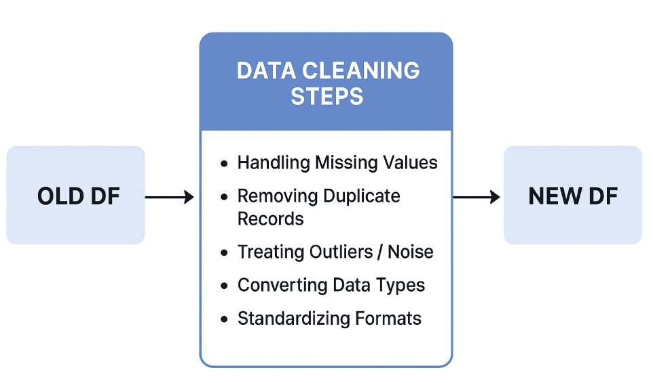
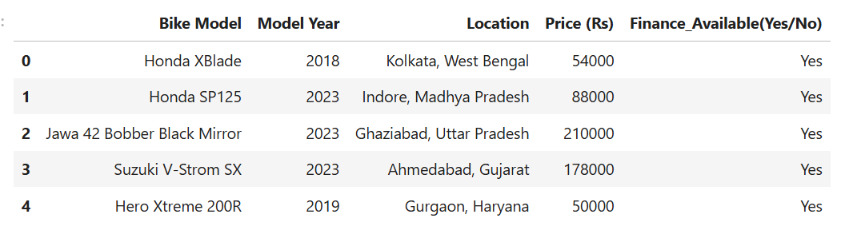
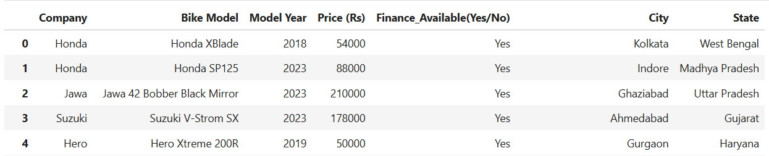
Data Cleaning
Old :-
New :-

Slide 8
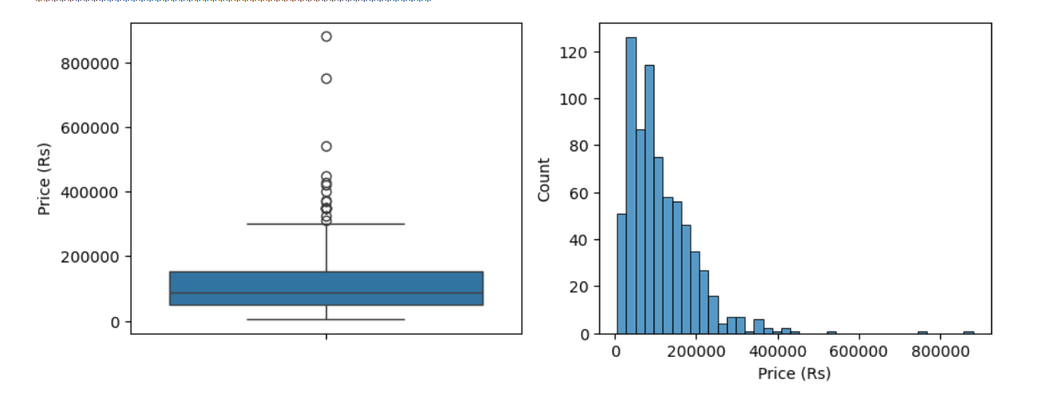
Univariate Analysis :-
Numerical Columns :-
Price
The majority of used bikes are priced below ₹200,000, with most falling in the ₹50,000 to ₹150,000 range, indicating affordability for a large market segment.
A few outliers exist with prices well above ₹300,000, representing premium or rare bike models that are less common

Slide 9
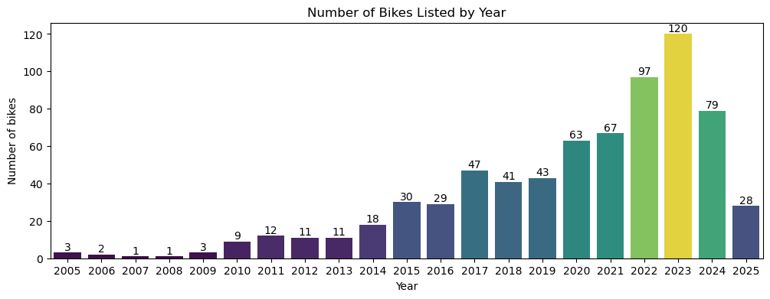
The number of bikes listed increased steadily from 2005 to 2015, then surged sharply from 2017 onward.
2023 had the highest listings at 120, indicating peak market activity or inventory.
The listings slowed down in 2024 and 2025, possibly due to market changes or incomplete recent data.
Overall, the data shows strong growth in bike listings over the last decade, reflecting rising demand and market interest.
Year

Slide 10
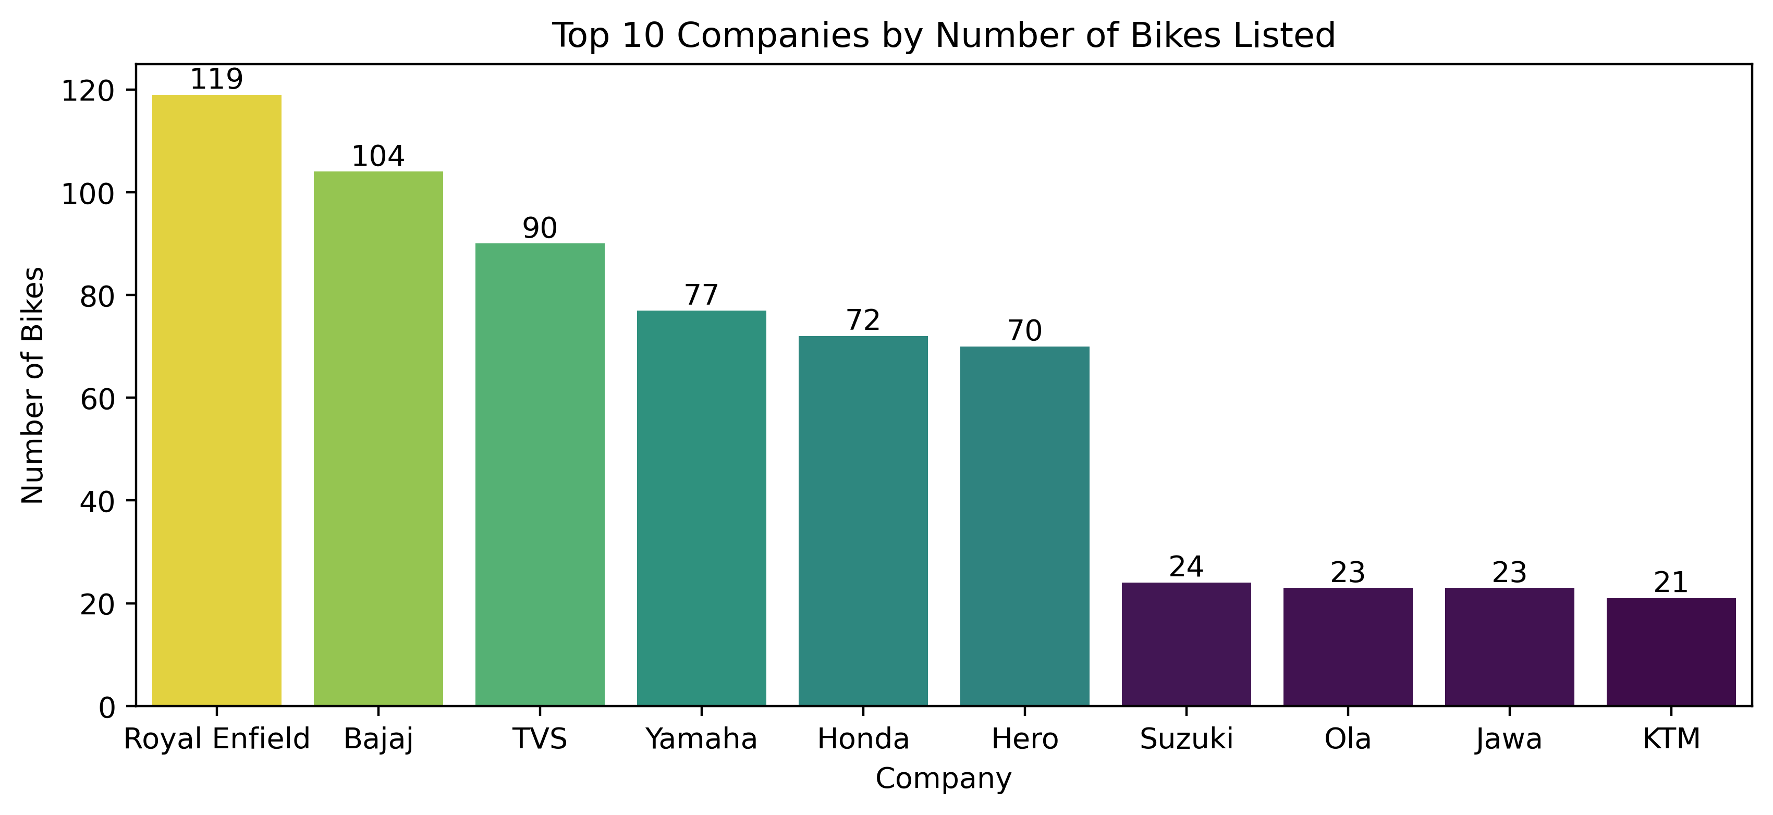
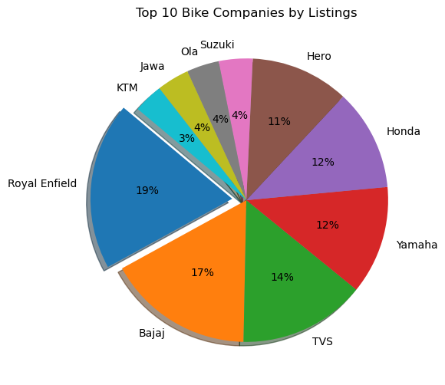
Categorical Columns :-
Top 10 Companies by Number of Bikes Listed
Royal Enfield tops the chart with 119 listings,holding 19% of total Bike's listed.
Bajaj and TVS follow with 104 and 90 bikes, holding 17% and 14% respectively.
Suzuki, Ola, Jawa, KTM each have under 30 listings, showing lower demand.
The pie chart confirms Royal Enfield’s lead, with others trailing behind

Slide 11
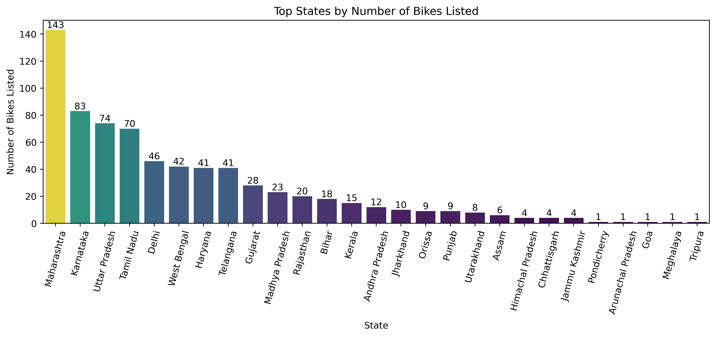
States with the highest number of bikes listed
State Maharashtra has the highest number of bikes for sale.
State's like Pondicherry, Arunachal Pradesh, Goa, Meghalaya, and Tripura has lowest number of bikes for sale.

Slide 12
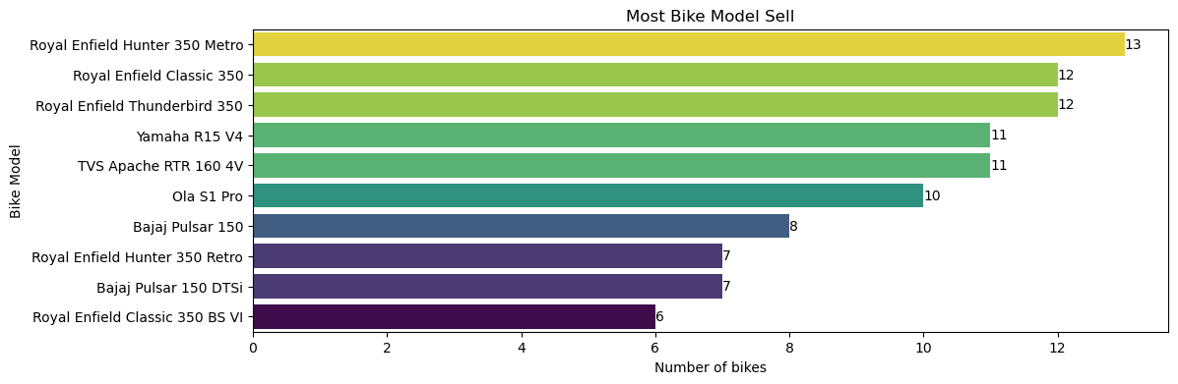
Which bike model is most selled.
The most popular second-hand bikes are from Royal Enfield, with models like Hunter 350 Metro, Classic 350, and Thunderbird 350 leading sales.
Other popular used bikes include Yamaha R15 V4, TVS Apache RTR 160, and Ola S1 Pro.
Royal Enfield’s strong resale presence highlights its brand loyalty and demand in the used bike market

Slide 13
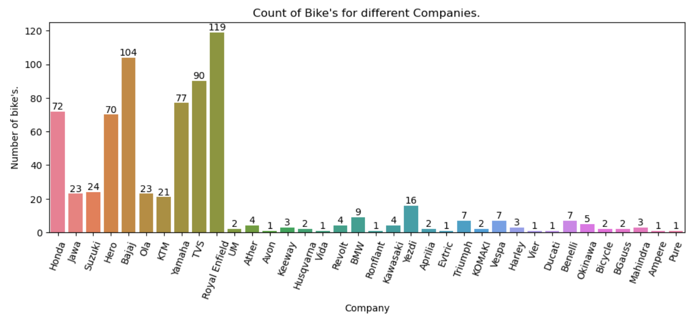
How many bike models are available for sale from different companies?
Royal Enfield, Bajaj, TVS, and Yamaha have the highest numbers, indicating strong resale activity and popularity in the second-hand market.
Brands like Honda and Hero also have notable listings, while most other companies appear rarely, showing limited demand or presence in used bike sales.

Slide 14
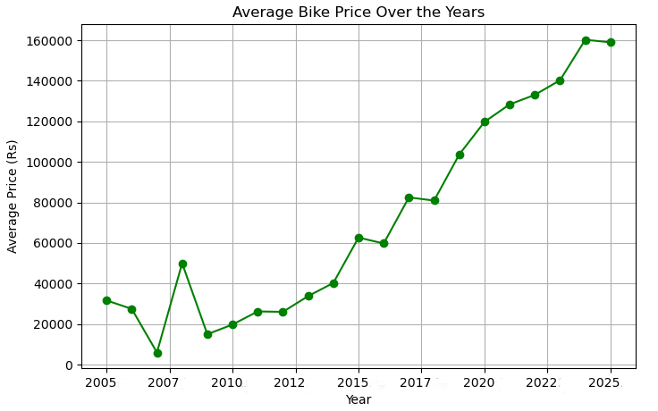
Bivariate Analysis:-
Bivariate Analysis:-
How did the average bike price change over the years
The rising prices indicate more people are selling and buying used bikes.
Average bike prices have increased sharply since 2015, reaching over ₹160,000 by 2025.
This upward trend reflects growing demand, inflation, and the popularity of premium bike models in the second-hand market
Growing demand in the resale market reflects affordability and preference for pre-owned bikes.

Slide 15
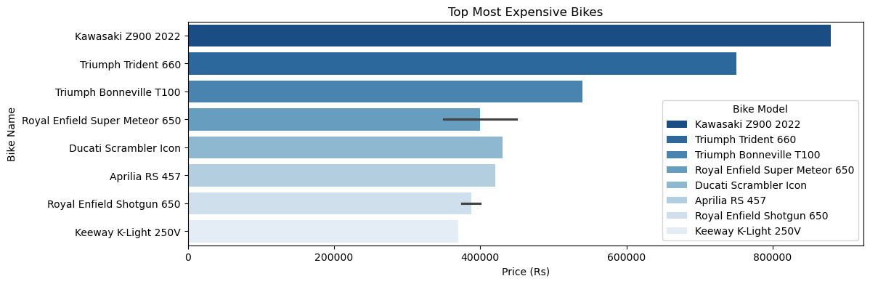
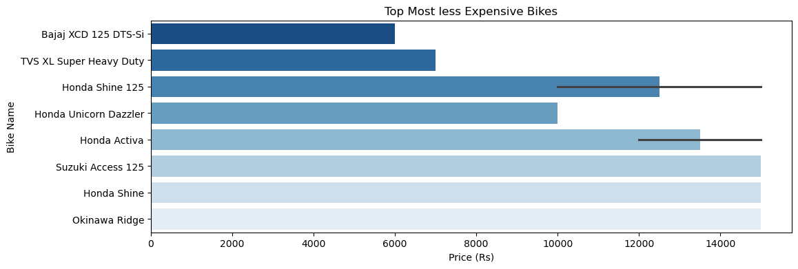
Top most and less expensive bike's
Top-priced bikes: Kawasaki Z900 2022 and Triumph Trident 660 are significantly more expensive than other models.
Brand dominance: Triumph and Royal Enfield lead the premium segment with strong representation.
Bajaj XCD 125 DTS-Si is the cheapest in the list.
Prices depend on condition & demand.
Budget-friendly bikes = high resale turnover

Slide 16
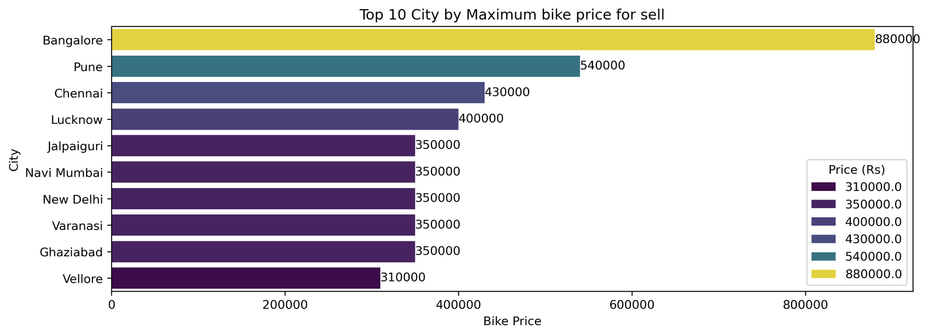
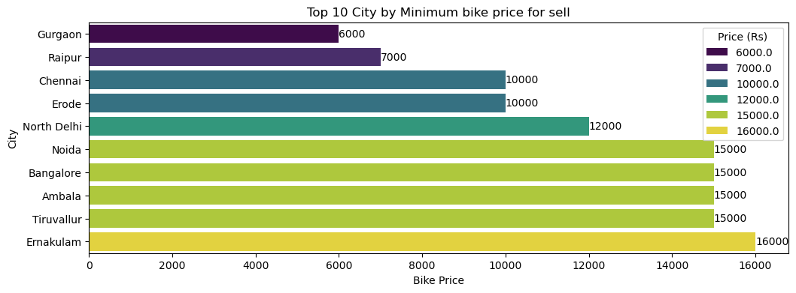
City With Maximum and Minimum Bike Price's
In City Banglore, in a state of Karnataka has the highest bike price around 8,80,000.
Metro cities like Pune and Chennai also show high average prices, indicating strong demand for second-hand bikes in these areas
The lowest minimum price is found in Gurgaon (₹6,000).
Cities like Noida, Bangalore, Ambala, and Tiruvallur have similar minimum prices at ₹15,000, indicating a higher price floor in those markets.

Slide 17
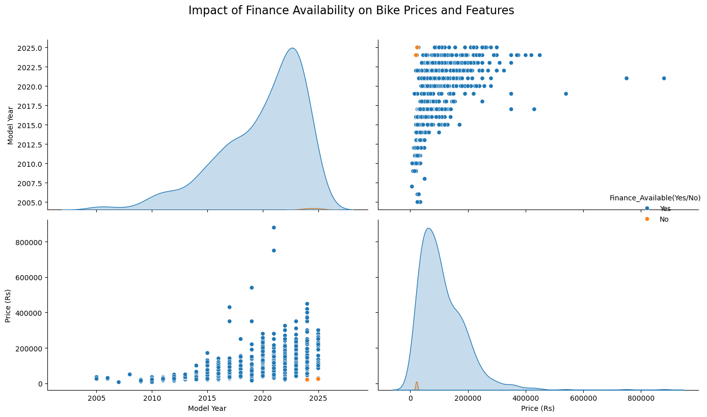
Multivariate Analysis :-
How does finance availability (Yes/No) affect the distribution of bike prices?
Most bikes are from 2015 onwards, peaking around 2020–2023.
Majority of bikes are priced below ₹2 lakhs.
The price of second-hand bikes generally increases with newer model years
Newer bikes have higher prices compared to older ones.
Finance is mostly available (“Yes”) across bikes.

Slide 18


Royal Enfield dominates the resale market with the highest listings & demand.
Most bikes are affordable, priced below ₹2 lakhs, attracting a wide audience.
Metro cities like Bangalore, Pune, and Chennai show higher prices compared to smaller towns.
Steady growth in listings since 2015, with 2023 being the peak year.
Newer bikes + finance availability → higher resale value, showing strong buyer preference.

Slide 19

The project analyzed the second-hand bike market, identifying Royal Enfield, Bajaj, and TVS as top brands. Prices were closely linked to model year, and cleaned data ensured accurate insights for better pricing and customer experience.

Slide 20


